Slide 1
Inoculation Against Misinformation
Milestone 1:
Experiment Design and Pre-analysis Plan
Team: Reka Zempleni, Ben Ditchfield, Quentin Hsu, Ross Dahlke, Kushagra Gupta

Slide 2
Project Context + Motivations
Misinformation requires context & related behavior
Limited by 15 minutes survey + course
Manipulative tactics commonly used to deliver misinformation
Goal: Teach participants several common tactics so that they can recognize these posts as manipulative.
Partner interest in less studied ones

Slide 3
Roadmap
1
2
3
Introduction
Experiment
Design
Analysis
Plan
Motivation
General considerations
Research questions
Overview
Treatment
Outcomes
Covariates
Hypotheses
Power analysis
Planned analyses

Slide 4
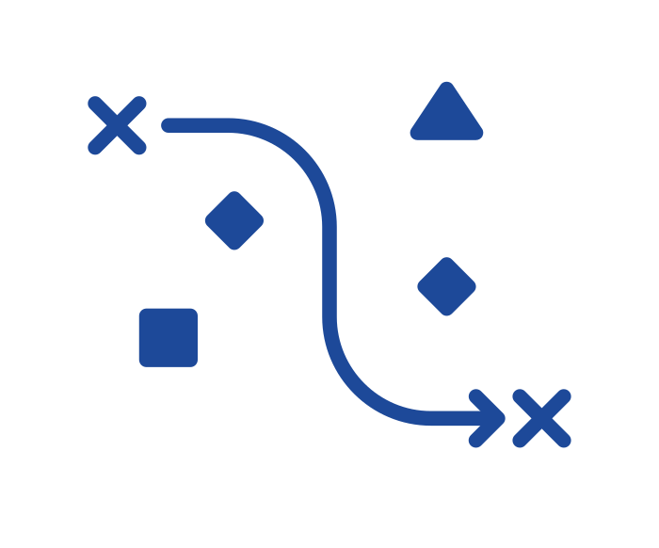
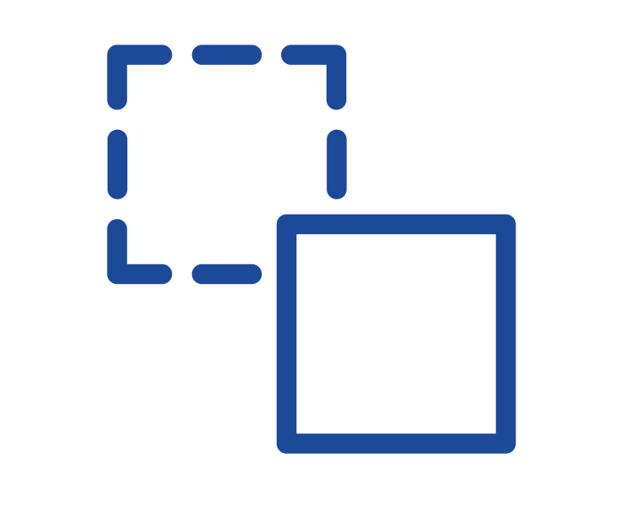

Motivation
Context
Online misinformation is a threat
Objectives
Identify low-cost intervention to reduce misinformation susceptibility, inc. identifying it & sharing it less frequently
Approach
Teaching manipulative tactics and analyzing how well respondents’ in different subgroups can subsequently identify each one
Notes:
Quick introduction to why this is important + big picture goals and very big picture of our approach. Disclaimer about misinformation versus manipulative information

Slide 5

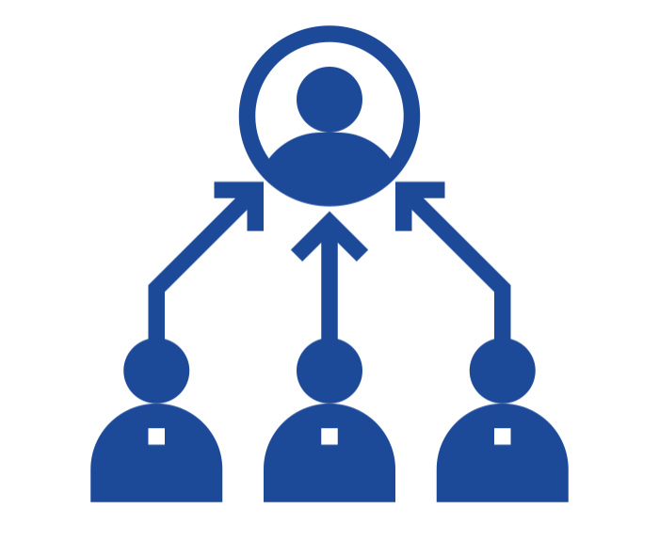
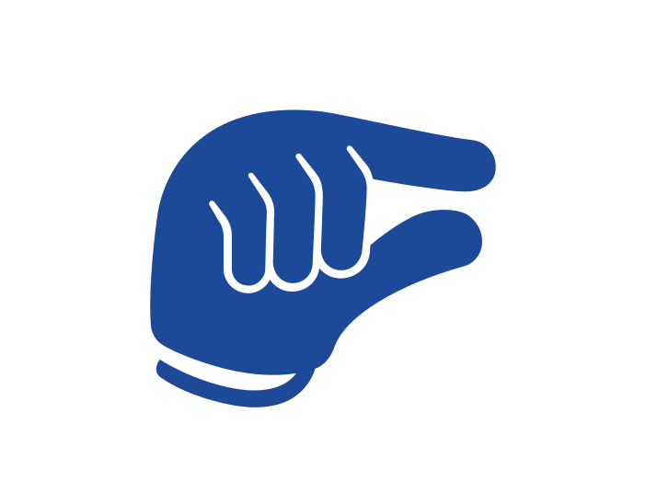
Considerations
What is the best use of the limited sample and time?
Limited time and sample size
Deliver the most effective course possible, focused on specific, less studied tactics:
Misleading graphs
Anecdotes
False comparisons
Representative sample (no targeting)
Draws on input from literature & partner
Recognizes misinformation and behavior is context specific
May help with low power
Partner expects us to see small effects
Notes:
General considerations and big picture of what we are doing, how we get to the research questions

Slide 6
Research Questions
Can a 6 minutes mini tactics course help users better identify manipulative content?
Does the course help reduce sharing of manipulative content online and offline?
How effective is each of the three course elements?
Are there heterogeneous treatment effects where our course works better for certain subgroups than others?
Based on susceptibility, ideology, and income
I
II
III
IV
Notes:
based off of First Draft News’s “inoculation against misinformation” SMS course

Slide 7
Experiment Design - Overview
Demographic Questions
Placed first in the survey to:
Produce clean covariates for HTE analysis
Avoid influencing treatment effects
Pre-Test
Baseline ability to identify manipulative tactics & willingness to share
Treatment
6 minute course teaching 3 manipulative tactics
Post-Test
Different but analogous questions to pre-test (randomized)
Control
6 minute course teaching 3 reasons why we sleep
Notes:
Produce clean covariates for HTE analysis = Avoid influence on covariates by pre-test (or by entire thing)

Slide 8
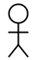
Pre-Post Testing with Control
Pilot Design
Control
Inter-person variance = lower power
3 separate comparisons
Treatment 1
Treatment 2
Treatment 3
Fewer samples per arm = lower power
1 test = less time taken

Slide 9
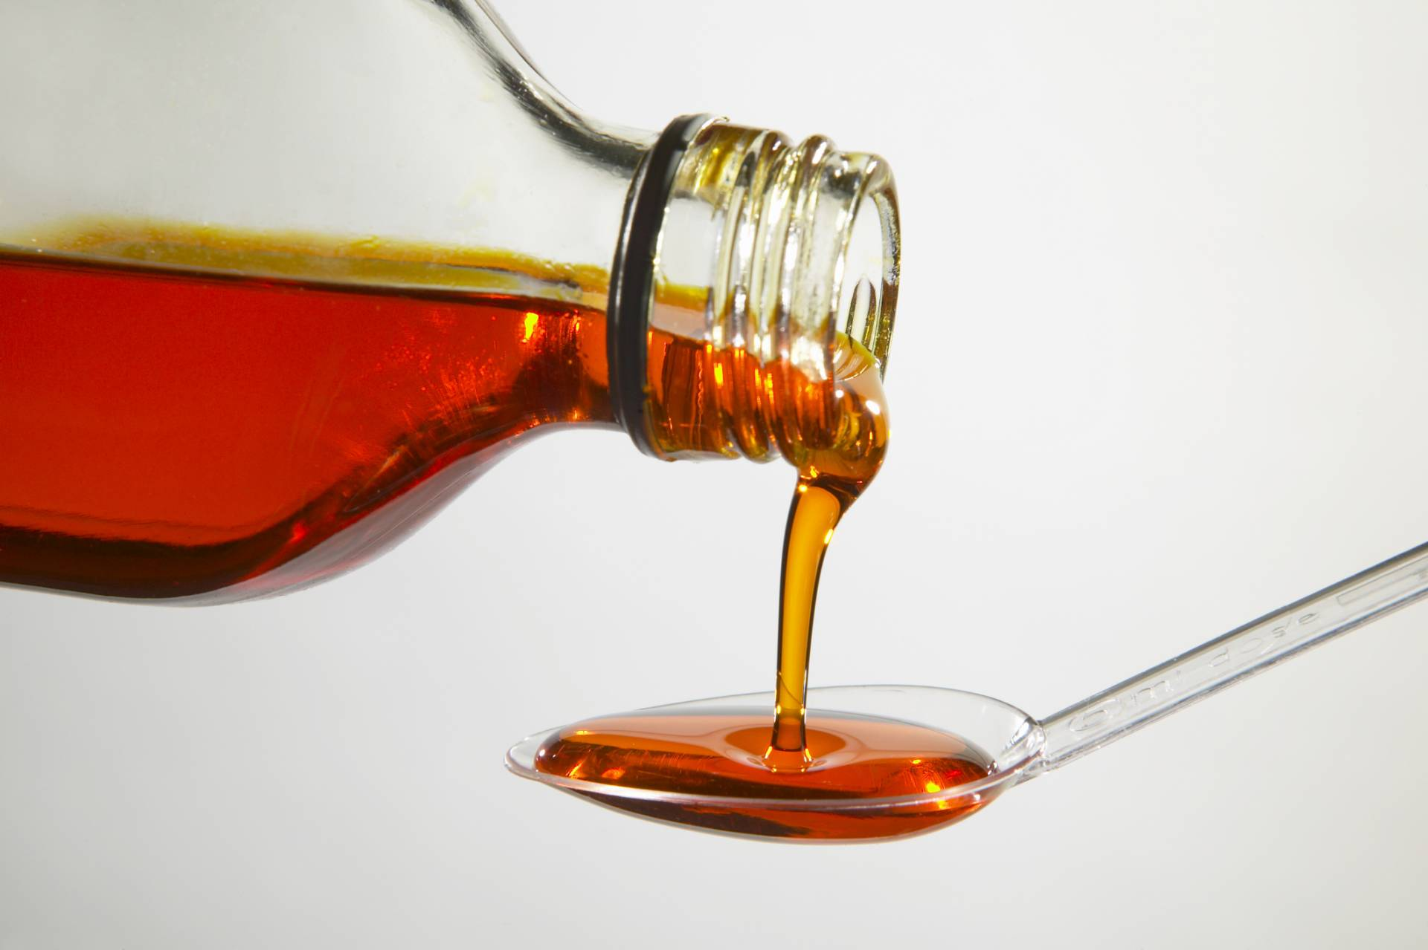
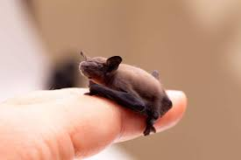
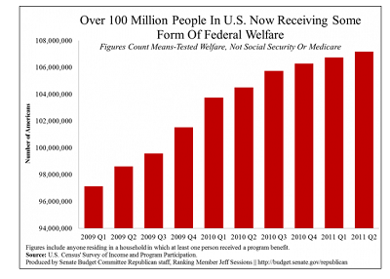
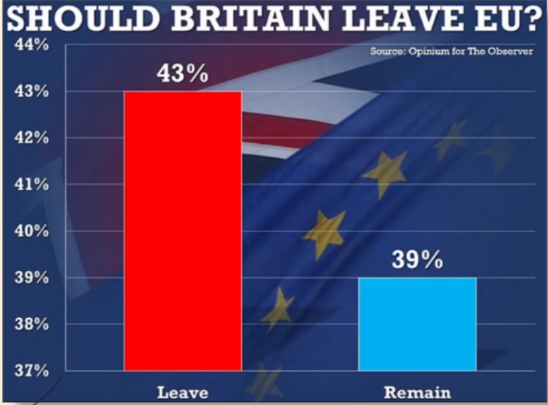

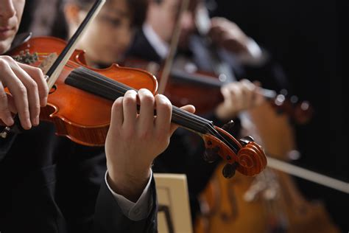
Pre-Post Testing with Control
New Design
More samples = more power
Pre Test
Control
Post Test
2 Truths
2 Truths
Lower variance
More treatment units
3-4 Tactics
3-4 Tactics
Treatment 1
Questions are stratified, then randomized
Matched results = higher power
2 tests = longer time + need for comparability

Slide 10
Pre-Post Testing with Control
Considerations
Design
Reduced variability since we match participants to themselves. This means higher power overall.
Longer survey time (less time for other elements)
Need to ensure comparability
Each topic has a pair of examples. We randomize which pair element is used pre and post test per participant.
Control group has a neutral treatment teaching them about sleep (using comparable format)

Slide 11
Treatment Overview
Mini-course focused on 3 tactics
Misleading graphs (original course)
Anecdotes (new!)
False Comparisons (new!)
Enhanced delivery with more interactivity
6 minute control course that is independent from outcomes

Slide 12
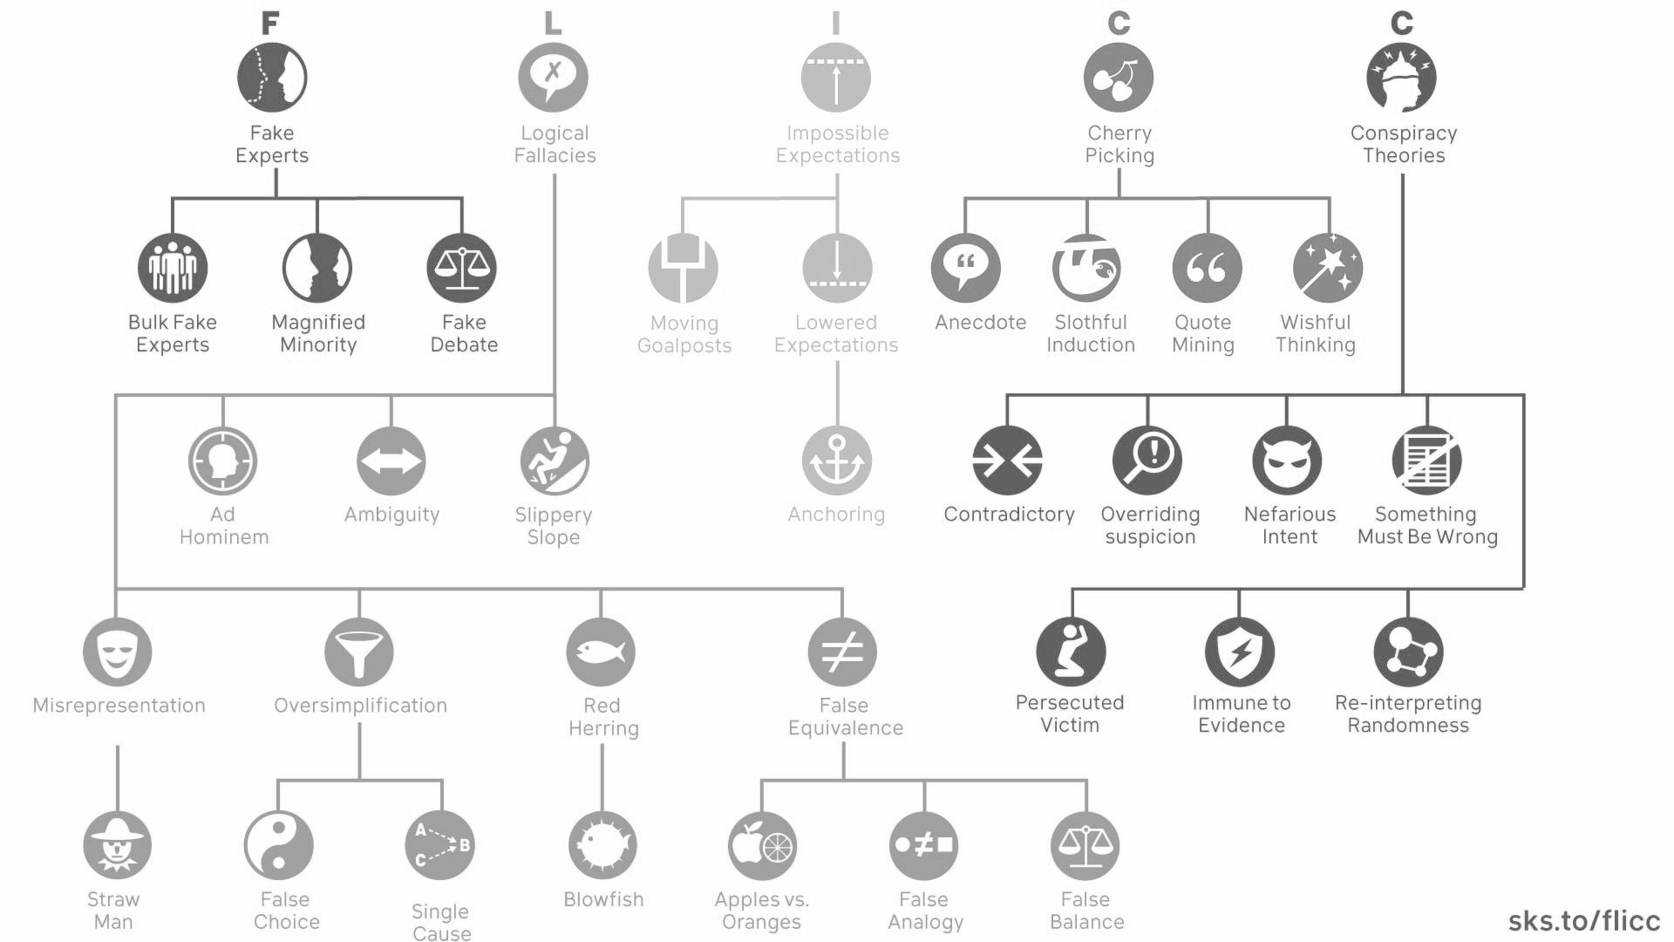
Treatment - New Tactics

Slide 13
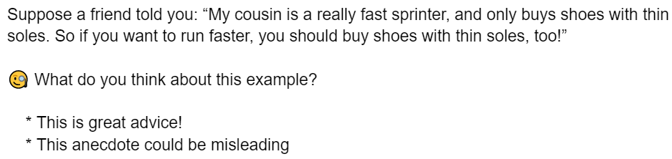
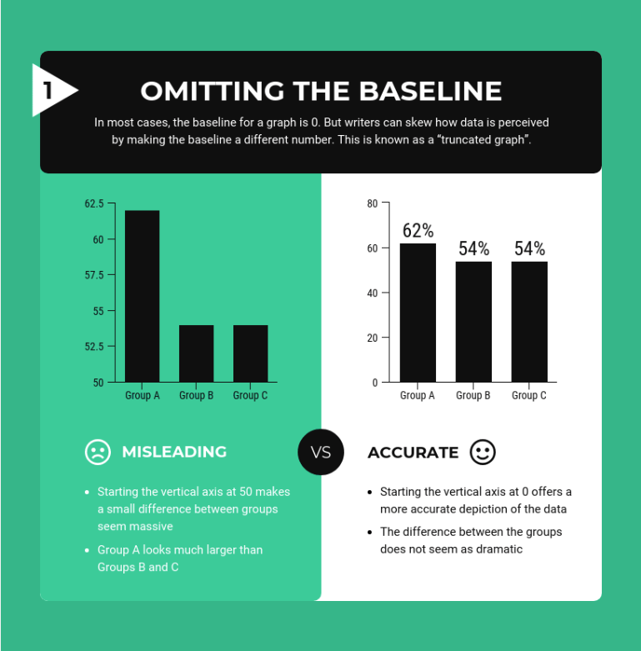
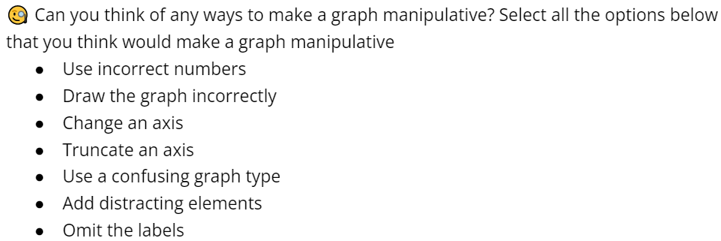
Treatment - Delivery
SMS Style Snippets
Examples
Infographics
Interactive Questions

Slide 14
Treatment - Control Task
6 minute control course that is independent from outcomes
Educative topic
Neutral topic
Not extremely boring, but also not too interesting
Why We Sleep

Slide 15
Treatments
Focused mini-course on tactics
Misleading graphs
Anecdotes
False Comparisons
Educative delivery similar to First Draft’s SMS course
Additional examples and interactive components to better deliver the concepts & effectiveness based on literature
Why we dropped delivery method (Delivery methods - use the best one, based on literature and partner (considered multiple treatments) → get best chance to have an impact & tactic effects & focus on HTEs)
Finding the right control (e.g. sleep, freezer burn, macula degeneration), deciding on tactics
Additional considerations: Neutral tone (not polarizing topics) Partner interest in less studied tactics

Slide 16

Outcome Questions
How manipulative do you find this post? (6 point scale)
Which aspect of the post is manipulative?
Would you like to share this post on social media? (6 point scale)
Would you want to talk to others about this information offline? (6 point scale)
Not dependent on context/past knowledge
Question combines binary and confidence questions, while still forcing participants to pick a side
Uses same scale as “Go Viral Game,” and same style as Roozenbeek & van der Linden (2019)
Other considerations in appendix
Notes:
What is desired behavior for true and false?
How do we ask the question to get truthful/accurate responses that are reflective of what users would actually do?
How do we prevent the questions from biasing future answers?
What questions/behaviors are topic agnostic?

Slide 17
Covariates
Demographic questions will help identify HTE. Covariates selected based on 3 factors:
HTE performance on pilot data | Trust in Dr. Fauci Income Race Think & reflect Searching for political news Blocking behavior on social media
Promising covariates in the literature | Susceptibility to misinfo based on pre-test (Roozenbeek and van der Linden 2019; Cook et al, 2017) Political interest and ideology (Guess et al, 2020; Chen et al, 2021)
First Draft priorities | Partisanship Education (income is proxy/related)
Notes:
Susceptibility: from literature and related to partner, Income from HTE and related to partner, Ideology from literature and partner

Slide 18
HTE performance on pilot
Covariate | Treatment | p-value corrected | estimate | std error
Block User Social Media | Tactic Quiz | 0.0006 | -3.74559 | 0.97026
Income | Tactic | 0.082 | -1.063796 | 0.525675
Think & Reflect | Tactics | 0.082 | -0.82738 | 0.47397
Block User Social Media | Tactics | 0.057 | -2.38104 | 1.01160
Fauci Trust | Tactics Quiz | 0.082 | -0.70682 | 0.39451
Search Political News | Tactics Quiz | 0.082 | -0.60098 | 0.34450

Slide 19
Hypotheses* (1/2)
H1: Participants will improve in rating misinformation as manipulative after taking the course ( |Δ_{post - pre} score identify|_{treatment} > |Δ_{post - pre} score identify|_{control})
score identify = outcome 1 if choice matches ground truth
= 7 - outcome 1 if choice opposite to ground truth
H2: Participants will be able to identify the 3 specified misinformation tactics better after taking the course ( |Δ_{post - pre} precision T|_{treatment} > |Δ_{post - pre} precision T|_{control})
precision T =
# tactics correctly identified
# of posts shown
* We expect small effect sizes ~ 10%
Notes:
H1: Participants will rate misinformation as significantly more manipulative after taking the mini-course.
H0,real: Participants will not rate real news as significantly more manipulative after taking the mini-course.
H2: Participants will be less likely to share misinformation after taking the mini-course.
H3: Participants will be more likely to research/fact check misinformation after taking the mini-course.

Slide 20
Hypotheses* (2/2)
H3: Participants will be less likely to share misinformation online after taking the course ( |Δ_{post - pre} share misinfo likelihood|_{treatment} < |Δ_{post - pre} share misinfo likelihood|_{control})
H4: Participants will be less likely to share misinformation offline after taking the course ( |Δ_{post - pre} share misinfo likelihood|_{treatment} < |Δ_{post - pre} share misinfo likelihood|_{control})
Share misinfo likelihood = Outcome 3/4 for misinformation questions
* We expect small effect sizes ~ 10%
Notes:
H1: Participants will rate misinformation as significantly more manipulative after taking the mini-course.
H0,real: Participants will not rate real news as significantly more manipulative after taking the mini-course.
H2: Participants will be less likely to share misinformation after taking the mini-course.
H3: Participants will be more likely to research/fact check misinformation after taking the mini-course.

Slide 21
Power overview
Simulation-based study
Corrections
Focused on:
Feasibility of experiment
Treatment and control design
Number of HTE to test
Multiple hypothesis corrections for correlated outcomes:
Romano-Wolf
Bootstrap
Benjamini-Hochberg
Detailed analysis follows

Slide 22
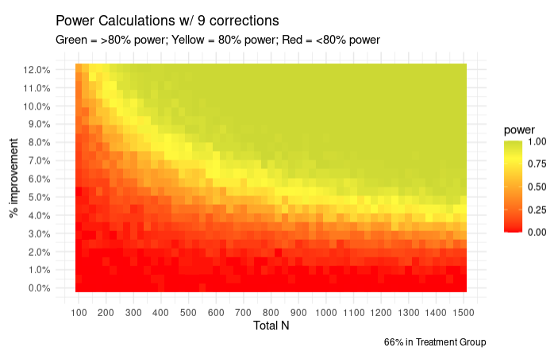
Power – Is our experiment feasible?

Slide 23
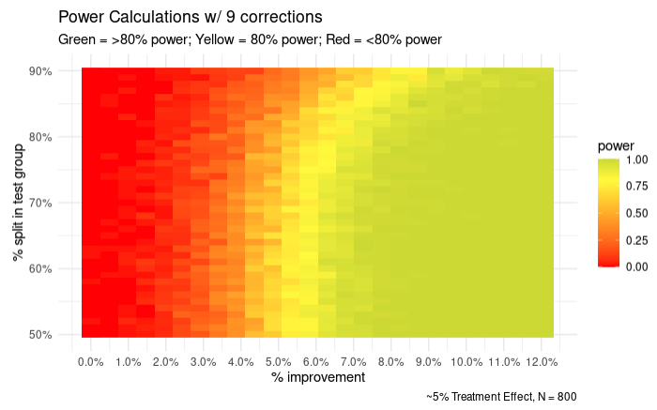
Power – How to split treatment and control?

Slide 24
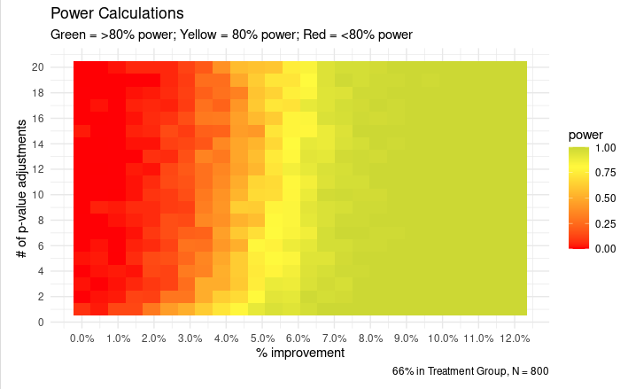
Power – How many HTE can we handle?

Slide 25
Analysis Plan
Data processing, covariate balance, and outcome metric calculation
Regression analysis of treatment effects on the outcomes
HTE analysis:
Analyze the pre-specified limited number (~3) covariates to detect HTE while maintaining power:
Susceptibility
Political ideology
Income
Also use a causal tree learning to leverage ML for HTE detection (may not report)
Multiple hypothesis testing correction
Power analysis through simulation (post experiment sanity check)

Slide 26
Appendix

Slide 27
Cited work
Roozenbeek, J., van der Linden, S. Fake news game confers psychological resistance against online misinformation. Palgrave Commun 5, 65 (2019). https://doi.org/10.1057/s41599-019-0279-9
Guess, A. M., Lerner, M., Lyons, B., Montgomery, J. M., Nyhan, B., Reifler, J., & Sircar, N. (2020). A digital media literacy intervention increases discernment between mainstream and false news in the United States and India. Proceedings of the National Academy of Sciences, 117(27), 15536–15545. https://doi.org/10.1073/pnas.1920498117
Cook, J., Lewandowsky, S., & Ecker, U. (2017). Neutralizing misinformation through inoculation: Exposing misleading argumentation techniques reduces their influence. PLoS ONE, 12(5): e0175799. https://doi.org/10.1371/journal.pone.0175799
Chen, C. X., Pennycook, G., & Rand, D. G. What Makes News Sharable on Social Media? preprint, PsyArXiv, 9 July 2021. DOI.org (Crossref), https://doi.org/10.31234/osf.io/gzqcd.

Slide 28
Outcome Questions - Additional Considerations
Fact Checking - Would you like to read more to find out the trustworthiness of this post?
Who would say no if there was no cost?
Discrepancy between answer and real life action
How to differentiate between researching more about interesting topic vs fact checking?
Reporting - Would you like to report this post to have it removed?
Our examples are neutral and not report worthy
Don’t want to encourage to report everything
Following - Would you stop following an account that posted content like this?
Topic/preferences specific
etc…

Slide 29
Facts: 3 each

Slide 30



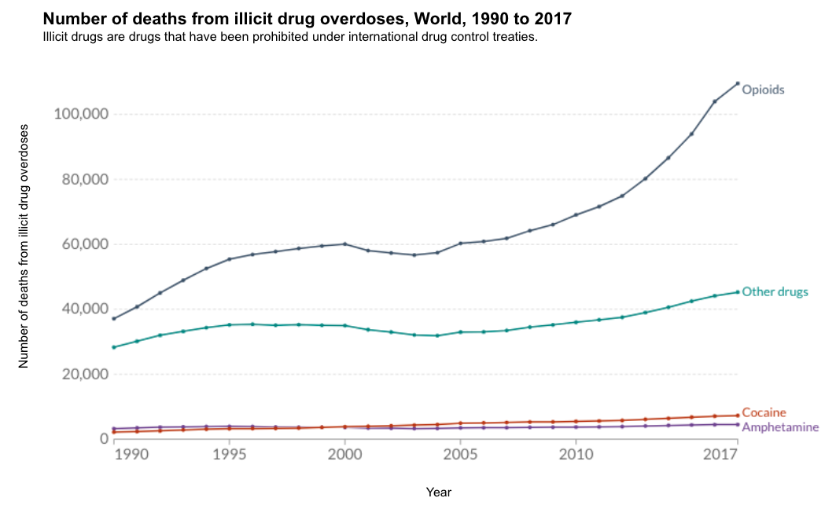
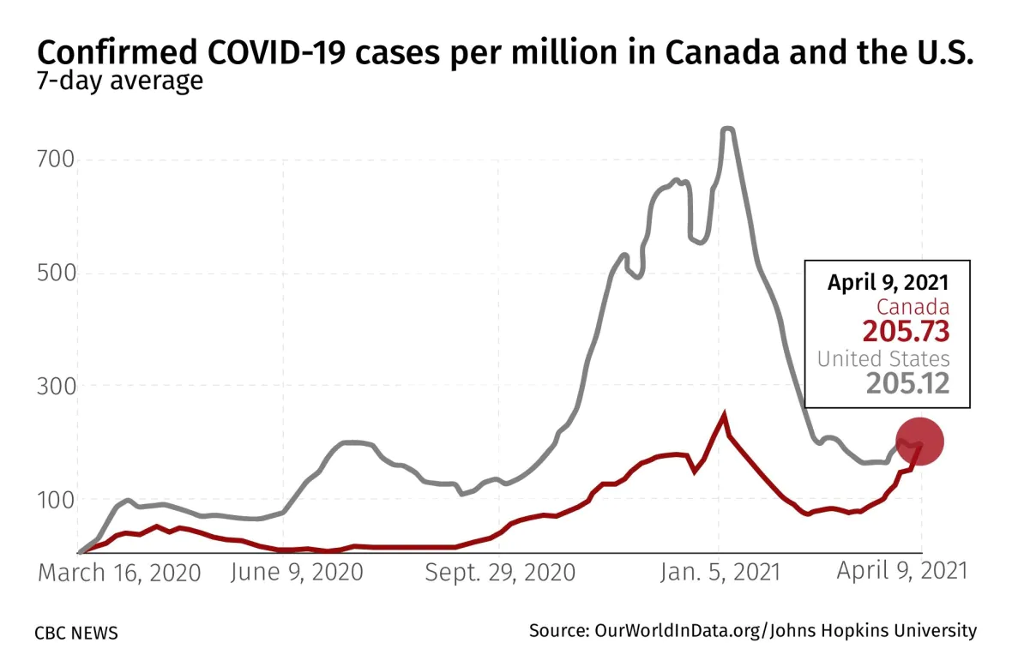
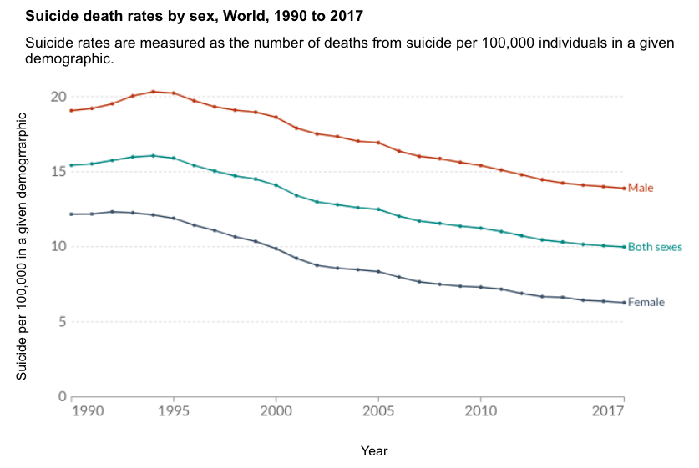
True Charts, Neutral Tone
Tom
4 hrs
Tom
4 hrs
Global overdose deaths from opioids more than doubled from 1990 until 2017. This is an important issue that needs more attention.
This graph shows how covid cases in Canada caught up to the US counts per million in April 2021. I worry about my parents who have been living in Canada since the lockdowns.

Slide 31

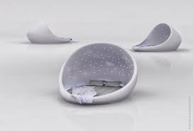
Truths
Sunne
4 hrs
Sunne
4 hrs
...
...
With a head-to-body length of 1.14 to 1.29 inches, the bumblebee bat is the smallest mammal in the world. To see this tiny bat for yourself, you’d have to visit one of a select few limestone caves on the Khwae Noi River in Kanchanaburi Province of southwest Thailand.
In 1986, eleven Russian men spent 370 days lying down in bed. The experiment was to help with future space expeditions, because a year in bed simulated weightlessness.

Slide 32
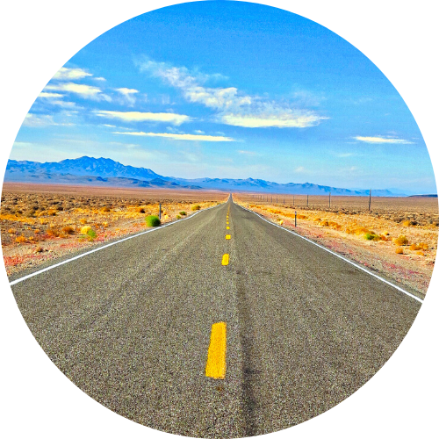

Truths
Tom
4 hrs
Tom
4 hrs
...
...
I read an article about how McDonald’s once made bubblegum-flavored broccoli. Unsurprisingly, the attempt to get kids to eat healthier didn’t go over well with the child testers, who were “confused by the taste.”
My sister is working on better solutions to solving obesity in communities without access to healthy food. It’s been shown that being overweight may shorten your life, in some cases by a decade or more.

Slide 33
Misinfo Tactics

Slide 34
Misleading Graphs
Tom
4 hrs
Tom
4 hrs
1,576,674
NO
8,430,222
YES
Support for unions has significantly decreased over the years. However, this new poll shows just how many workers actually support unionizing.
Recent polling has shown how most people think that britain should leave the EU.
Topics: Vaccine, Children

Slide 35

False Comparison
Tom
4 hrs
Tom
4 hrs
...
...
Trying to quit smoking? You should try the Lharbanti Meditation technique that has been scientifically proven to help thousands of people overcome their addiction to video games.
Studies have shown that students who attend schools with expansive music programs tend to perform much higher on standardized testing. If your child is struggling with grades, enroll them in the Von Gesualdo music program!

Slide 36
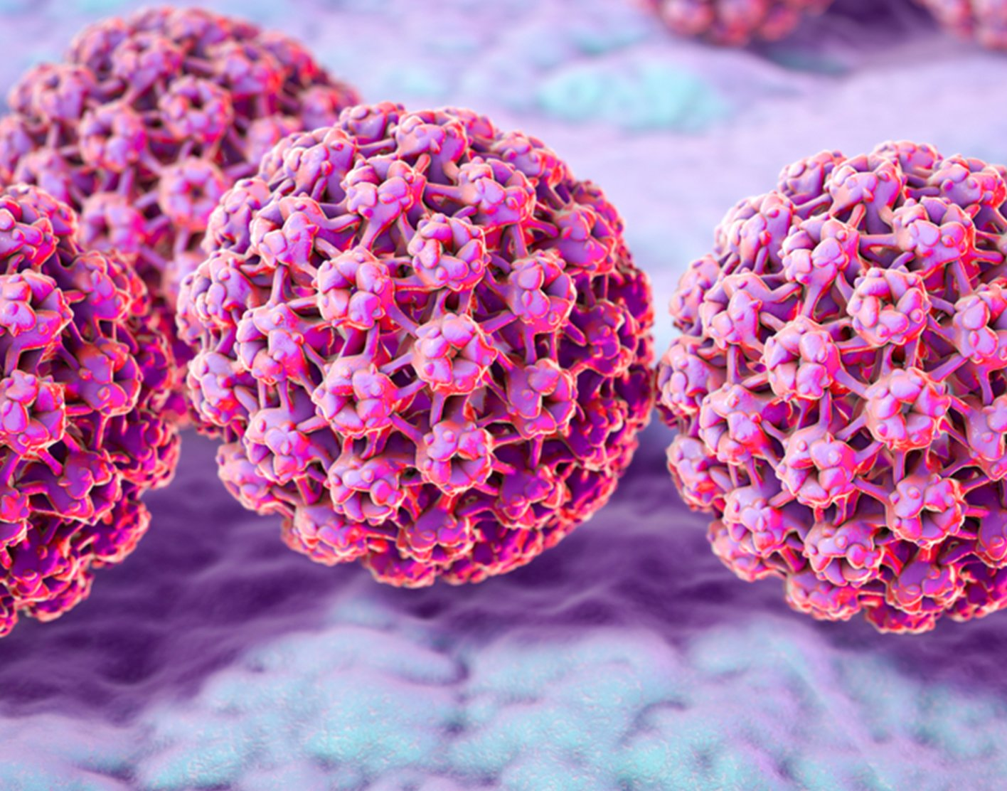


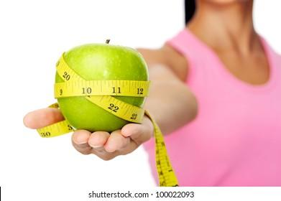
Anecdotes
Tom
4 hrs
Tom
4 hrs
...
...
My grandmother smoked a pack of cigarettes a day and ate whatever she wanted. She outlived my grandfather who restricted himself to a vegetarian diet. This shows that the secret to longevity is to live freely, doing what you enjoy.
Last month, my friend recommended a diet plan focused around apples to prevent migraines. I have not had a headache since starting this diet. Who knew that apples were the secret to preventing headaches!

Slide 37
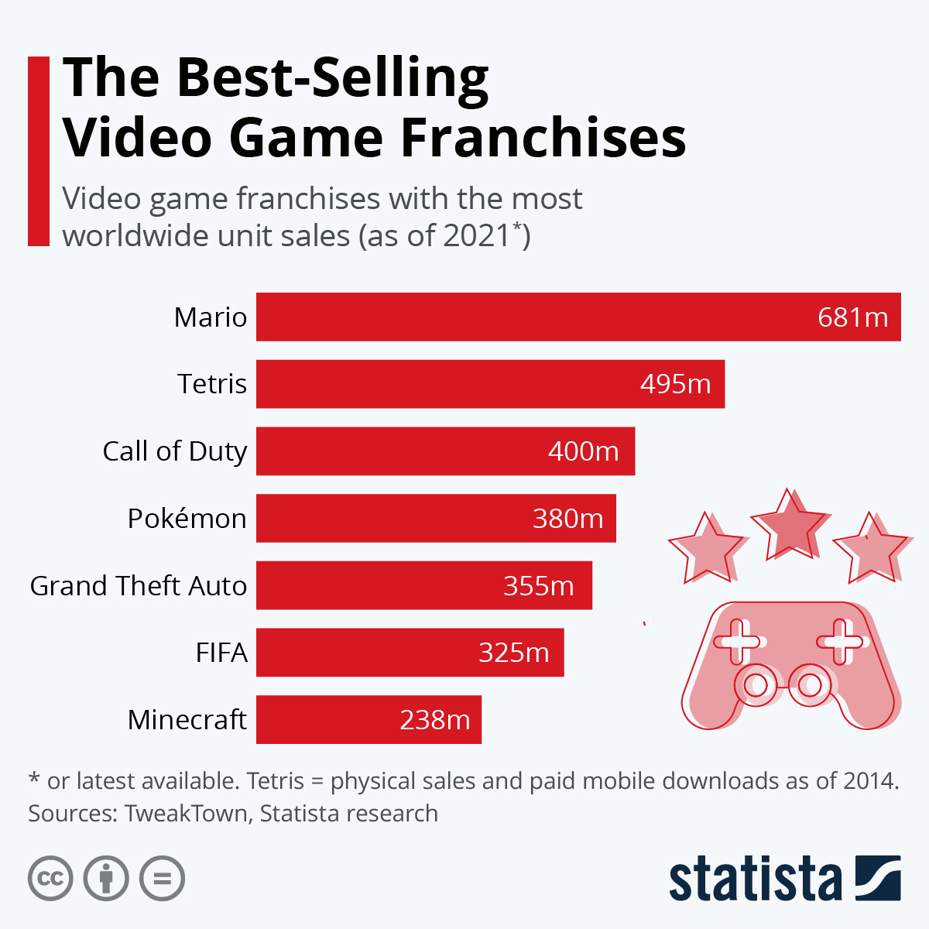
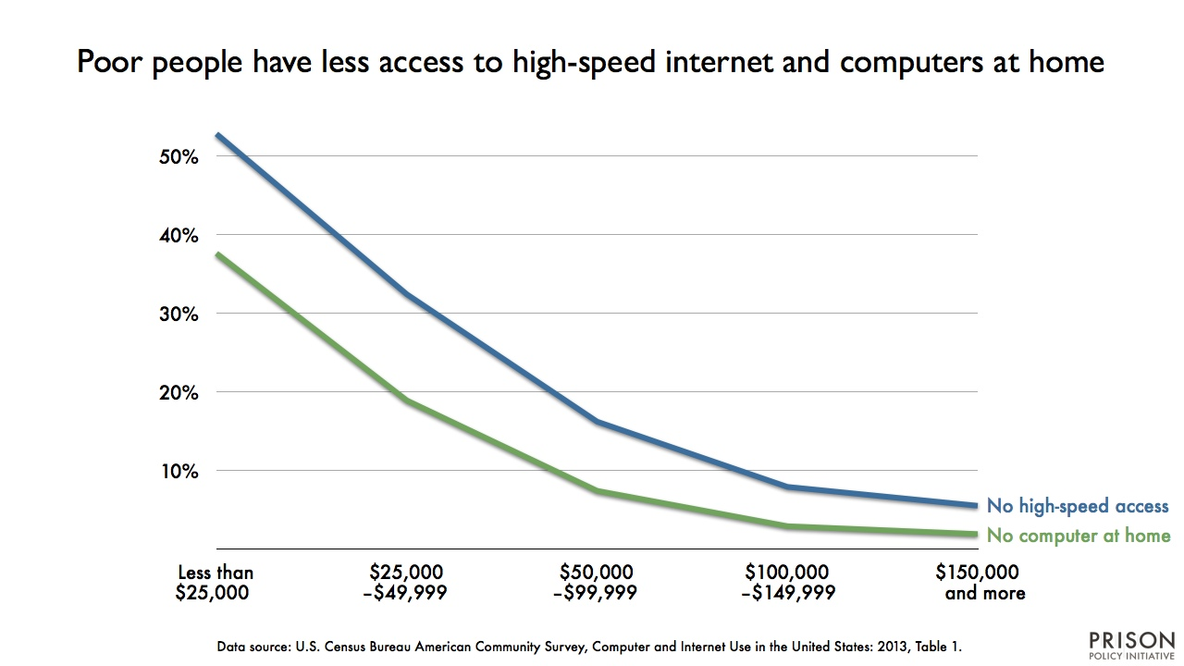
Combined
Tom
4 hrs
Tom
4 hrs
...
I grew up with slow internet speeds and now work at a minimum wage job. Parents should set their children up for success by subscribing to high speed internet and getting the fastest computer they can afford.
My younger brother loves mario and tetris, which are the best selling video games in 2021. Movie studios should release a mario tetris collaboration movie, which would be a huge success with young boys.

